Slide 1
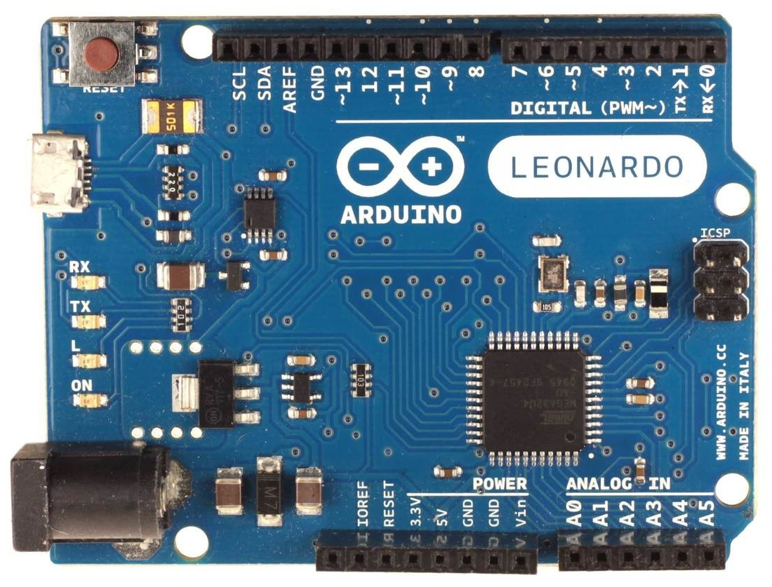
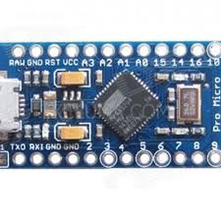
Arduino Leonardo or Micro
Arduino Leonardo FFB wheel fw-v24X pinout:
GND - common ground
5V - VCC for all devices
A0 - throttle pot
A1 - brake pot (if LC* - clutch pot)
A2 - clutch pot (if LC* - handbrake pot, else button8)
A3 - handbrake pot (if LC* - button0, else button9, or R**)
A4, A5 - buttons 1,2 (fw-v240, or XY shifter fw-v240f)
RX - channel A encoder
TX - channel B encoder
2 - channel Z encoder or SDA (data) for i2C devices
3 - SCL (clock) for i2C devices (fw-v240w, v240s, v243)
4 - DT pin for HX711 (fw-v242, button0 in fw-v240, or R**)
5 - CLK pin for HX711 (fw-v242, or button7 in fw-v240)
6 - DT_SR (fw-v241, or button4 in fw-v240)
7 - CLK_SR (fw-v241, or button5 in fw-v240)
8 - PL_SR (fw-v241, or button6 in fw-v240)
9 - left PWM channel
10 - right PWM channel
11 - PWM direction pin, or
motor (PWM) enable pin
12 - button3
13 - FFB clipping LED
X=0, 1, 2, 3
*LC - load cell with HX711 (fw-v242)
**R - reverse gear button
for XY shifter (fw-v240f)
To activate buttons
short them to GND,
unless firmware with
“t” option for
button matrix
Arduino ProMicro
Replacement pinouts for ProMicro:
16 - PWM direction, or motor (PWM) enable
3 - FFB clipping LED, or SCL (i2C)
14 - button1
15 - button2
2 - button3 (fw-v240m), or
encoder Z-index (fw-v240zm), or
center button (fw-v240cm), or
SDA (i2C) fw-v240sm,v240wm,v243m
SR - Shift register or button box
Hat Switch (fw-v24Xh):
Button0 - up
Button1 - right
Button2 - down
Button3 - left

